Slide 1
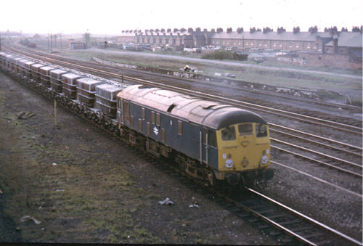
IT INITIATIVES ON INDIAN RAILWAYS
THE ROAD AHEAD

Slide 2

INDIAN RAILWAYS – A SUNRISE INDUSTRY
Railways in India, a sunrise industry!
Indian Railways, a super ‘ Navaratna’.
The Indian Railways (IR) is a truly great institution. It is a global giant that operates profitably, effectively and with relatively little government support.

Slide 3
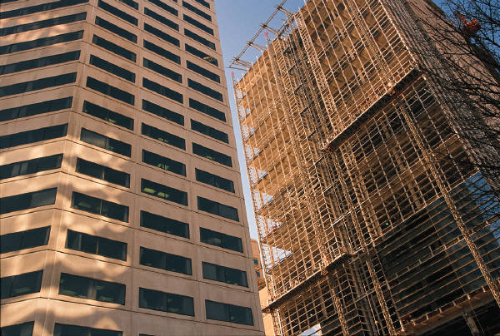

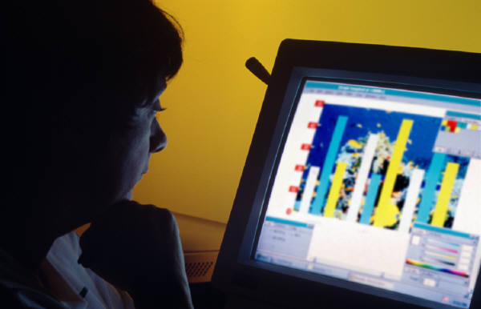
TODAY’S BUSINESS CHALLENGES
Increased operational efficiency
  Improve productivity from existing systems
  Streamline and optimize business procedures
Responsiveness to constituents
  Create end-to-end visibility into the business
  Make the information accessible and actionable
Adaptability to change
  Re-act quickly to threats and opportunities
  Turn IT into a competitive business asset

Slide 4
Current Issues
Higher demand for Freight and Passenger transport, with planned economic growth
Need for capacity enhancement in the Railway network over the next 10-15 years
Technological uprgadation for better maintenance of railway assets
Greater competition from Roadways, with major investments in Highway network upgradation
Increase freight market share through higher availability of services at competitive prices
Greater attention to passenger services and safety
Heavily subsidised passenger fares, distorted passenger pricing
Upgradation of the Railway Production units for improved efficiency and productivity

Slide 5
USING INFORMATION TECHNOLOGY FOR GREATER EFFICIENCY
A large complex Infrastructure System such as the Indian Railways can benefit greatly from the intelligent use of IT.
Objectives.
  Freight revenue enhancement
  Passenger revenue enhancement
  Improved and optimised service

Slide 6

Agency for implementation of IT
EDP Centers
CRIS
Zonal MIS Groups
LRDSS Group Under Planning Cell

Slide 7
EARLY STEPS
Data processing centers from 60,s
Legacy Applications
  Pay roll
  Inventory management
  Operating statistics
Applications evolved but functionalities remained the same
Attempts to create
  HRM
  MMIS
  Office Applications
Applications not system wide
Multiplicity of vendors
Problems in upgrading systems

Slide 8
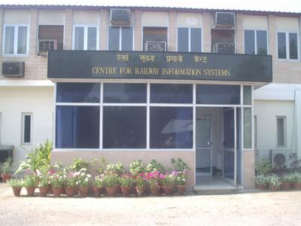
CRIS - INTERNAL SERVICE PROVIDER FOR IT ON IR
DESIGN, DEVELOPMENT AND IMPLEMENTATION OF COMPUTER BASED INFORMATION SYSTEMS AND ASSOCIATED COMMUNICATION NETWORKS AND PRODUCTS AND OTHER SYSTEMS
TECHNICAL SUPPORT AND SERVICES TO DEVELOP, SET UP, OPERATE AND MAINTAIN ANY COMPUTERISED SYSTEM AND THE UNDERLYING INFRASTRUCTURE

Slide 9
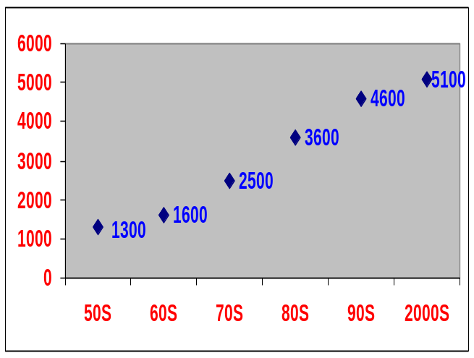
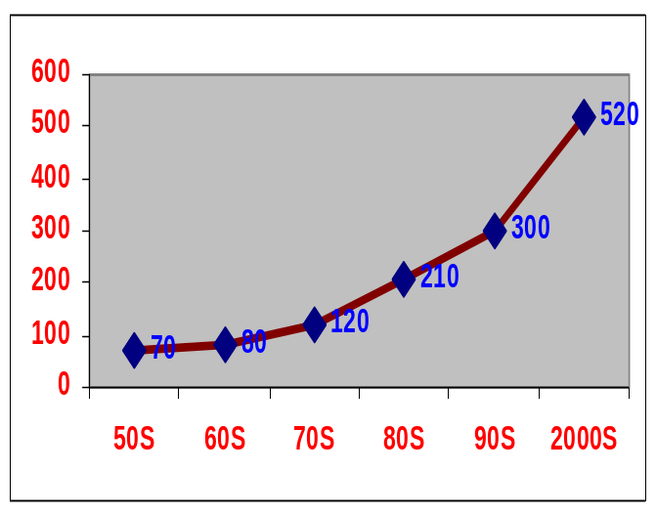
PASSENGER BUSINESS OF IR
PASSENGERS CARRIED (IN MILLIONS)
Indian railways have a share of nearly 22% in the passenger transport market
DURING 2003-04
  5210 Million passengers were carried
  Passenger kilometers was 530 billion
  Passenger earning was 13460 crores
Passenger business accounts for 31% of the revenue
Passenger business has two major segments
  Premium passenger service
  Mass Volume transportation segment
PASSENGERS KILOMETERS (IN BILLIONS)

Slide 10
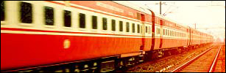
PREMIUM PASSENGER SERVICE
OFFERED THROUGH MAIL/EXPRESS, SUPER FAST, RAJDHANI AND SHATABDI TRAINS
ABOUT 1520 TRAINS ARE RUN DAILY.
VARIETY OF SERVICES
  AC FIRST CLASS
  AC SLEEPER
  FIRST CLASS
  AC 3 TIER
  AC CHAIR CAR
  SLEEPER CLASS
  ORDINARY CHAIR CAR
JOURENY THROUGH RESERVATION ONLY

Slide 11
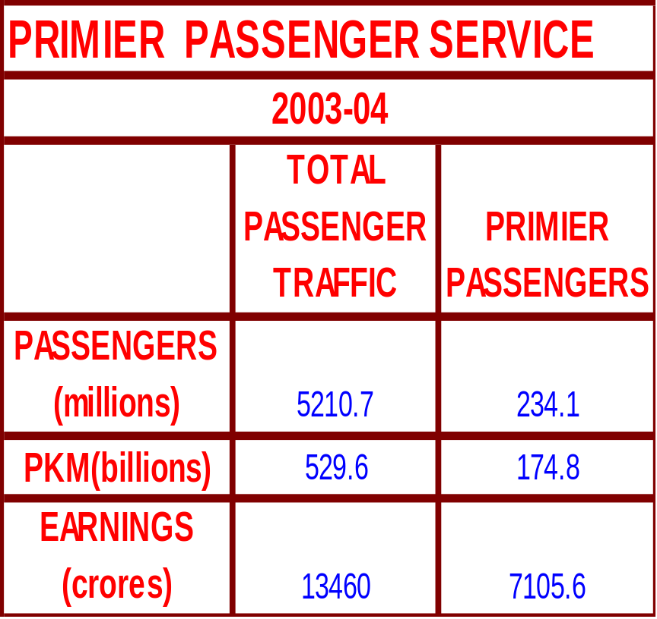
PREMIUM PASSENGER SERVICE
This segment accounts for
  5% of the passenger carried
  34% of the PKM
  53% of the passenger revenue
The average distance covered by each passenger is 760 kms
Revenue earned
  Per PKM is 40 paise
  Per passenger is RS310

Slide 12
PASSENGER RESERVATION SYSTEM
PRS networking of entire Indian Railways completed in April, 1999.
PRS is running currently at 1,200 locations, Deploying 4,000 terminals , covering journeys of 3,000 trains and executing ONE MILLION passenger transactions per day.
Internet booking of tickets was started In August 2002.
TATKAL has been converted from a separate coach to a normal Quota and enabled for all trains in 2004
Internet booking timings extended to 4:00 a.m. – 11:30 p.m. from March 2005.

Slide 13
CONCERT
(Country Wide Network of Computerised Enhanced Reservation and Ticketing )
  Integrates five Regional Reservation Centres
  Judicious mix local autonomy with uniformity of business rules.
  Very complex Business transactions.
  Comprehensive functionality
1 64 KBPS Leased Line6
1 2MBPS Leased line
CRIS
Delhi PRS
kolkata PRS
2 MBPS (x2) Leased Line
1 64 KBPS Leased Line6
1 2MBPS Leased line
Mumbai PRS
64 KBPS (x2) Leased Line
64 KBPS Leased Line
64 KBPS Leased Line
1 2MBPS Leased line
Secunderabad PRS
64 KBPS (X 2) Leased Line
Chennai PRS

Slide 14
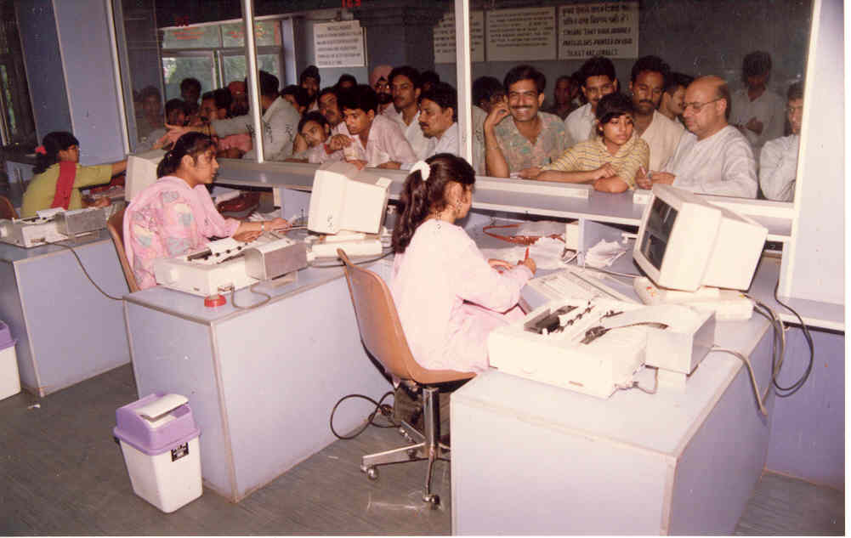
CONCERT Performance
  Less than 1 sec for local transaction
  3 sec for network transaction.
  Capable for providing reservations for 22 hours per day.
  Uptime of PRS is 99.5+%

Slide 15
CONCERT - COMPLEXITIES
44 types of quotas
8 types of trains
9 types of classes
162 types of concessions
127 types of bogies

Slide 16
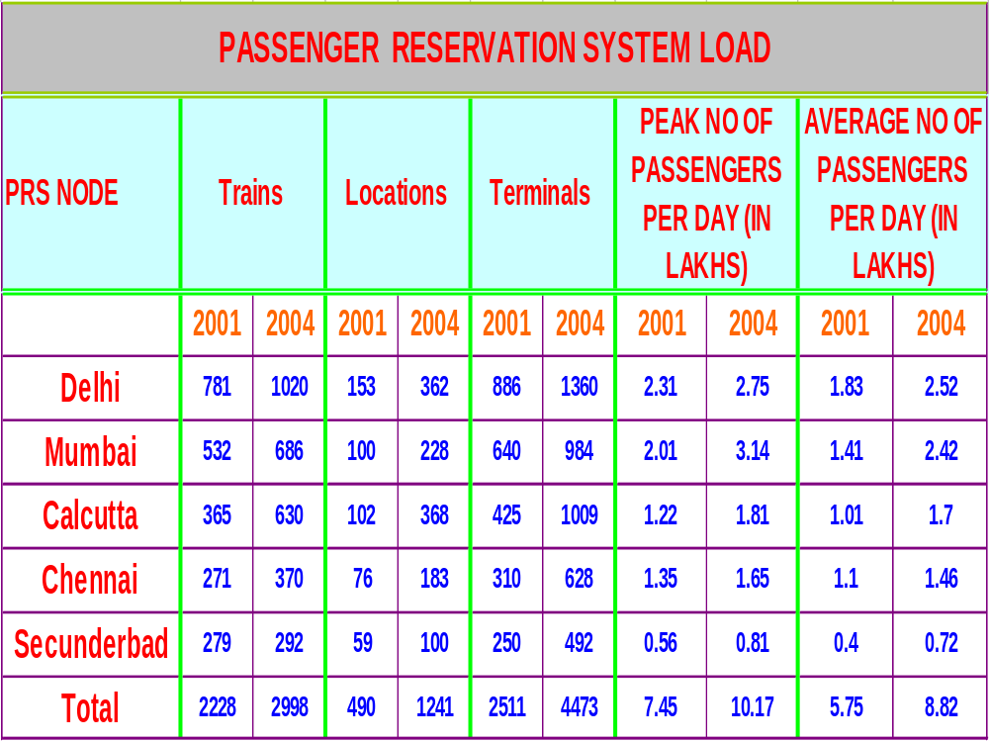

Slide 17
PRS – Enquiry Systems
Indian Railway’s web-site, www.indianrail.gov.in offers PRS enquiries on the internet Berth/Seat availability, Passenger Status, Fare, Train Schedule etc
A maximum of 42 lacs hits per day have been recorded
National Train Enquiry System (NTES) website, www.trainenquiry.com gives dynamic information about the running status of any train and its expected arrival/departure at any given station
Mobile telephone based SMS enquiry service
A new mobile phone based facility for rail users’ viz., Train Delay Alert Service
Country wide extension of Universal Rail Enquiry number “139” through setting up of Interactive Voice Response System (IVRS) based state-of-the-art Call Centres Request For Proposal (RFP) is being prepared.

Slide 18
PRS – WORKS IN PROGRESS
Display of Coach-wise Berth/Seat Vacancy Status
Reduction in Waiting List Numbers by utilizing vacant journey-legs of berths
E – Ticketing
Scheme of Frequent Rail Travellers (SOFT)
Hand-held Terminals for TTEs Fund allocated for this work is inadequate
Web based Ticket auction
Disaster backed PRS sites for business continuity.
Migration to RDBMS Architecture.

Slide 19
PRS – Data Warehouse
Reports giving passengers travelled and earnings realized train-wise for each class vis-à-vis the potential for a selected period have been made available at the five PRS sites.
PRS Data Warehousing Reports are now web enabled and are available all over Indian Railways on the website
Enhancements to enable Railway users to generate ad hoc reports themselves by using Business Intelligence (BI) Tools planned for the current year.
Fund allocation for this work is inadequate

Slide 20
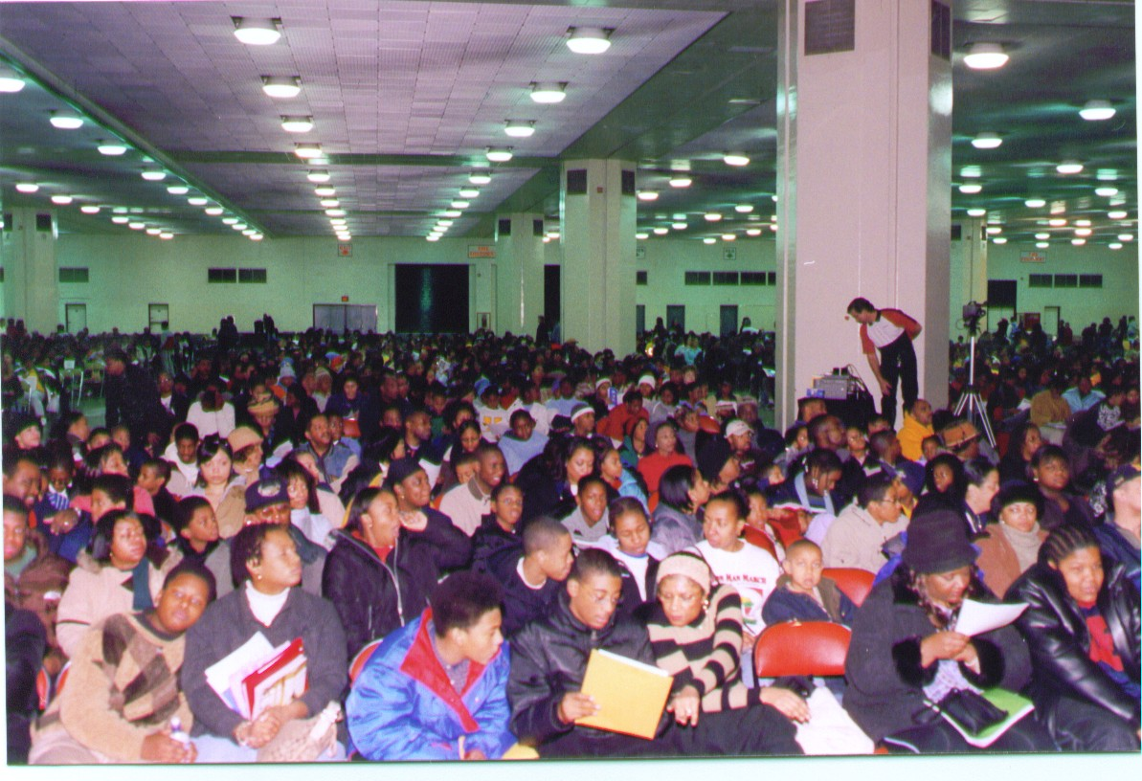
MASS VOLUME TRANSPORTATION
Consists of the following
  Suburban traffic
  Ordinary passenger service
  Unreserved short distance travel
This sector accounts for
  95% of the passenger carried
  66% of the PKM
  47% of the passenger revenue
Passengers of this category travel on an average 71 kms for every journey
Earning per pkm is 18 paise and per passenger is Rs 13

Slide 21
Unreserved Ticketing
System (UTS)
The work load involved in printing , accounting and issuing tickets to this mega segment has been a difficult task
Railways had also introduced electro-mechanical printing devices and also SPTM machines. But these methods had limitations
Indian railways introduced UTS to improve customer satisfaction, revenue generation, accounting, and reporting capabilities and reduce fraud
Printed card tickets have been in vogue since the beginning.

Slide 22
Unreserved Ticketing
System (UTS)
A pilot project was inaugurated in Delhi area in August 2002. Since then UTS has been extended to 51 important stations of Northern Railway.
UTS has also been extended to all the remaining Zonal Railways by connecting certain selected stations of each zones to the existing server clusters of Northern and Eastern Railways.
Five more UTS server clusters will be installed in South Eastern Railway, South Central Railway, Southern Railway, Central Railway and Western Railway during MAY – JUNE 2005
UTS server clusters installed in three more Zonal Railways viz., East Central Railway at Patna, North Eastern Railway at Gorakhpur and Eastern Railway at Kolkata. .

Slide 23
Works in progress in UTS
UTS is planned to be implemented at 500 more stations during this year
Thin Client based UTS successfully implemented on East Central Railway in March 2005. It is planned to gradually extend thin client based UTS to other locations so that ticketing activity can continue even if the communication link or the server goes down for some time.
Business Continuity for UTS under all circumstances the most important objective . inter-cluster UTS operation migration plannedto ensure continuous ticketing under all circumstances.

Slide 24
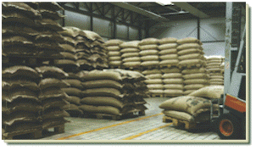
FREIGHT TRANSPORT BUSINESS
Freight Transport accounts for nearly 70% of IR’s revenue.
Railways meet approximately 45%of the national transportation.
In the financial year 2003-04, the Railways have moved 557.39 million tonnes of originating revenue earning traffic, against the target of 550 million tonnes and 38.65 million tonnes higher than the previous year’s loading. .

Slide 25

Freight Operations Information System
An on line real time system for management and control of freight traffic
FOIS
User driven design and implementation
Foundations for a total logistics system

Slide 26

Rake Management System (RMS)
RMS captures the following events in real time
Customer indents
Wagon supply - date and time
Departure after loading
Running particulars - arrival/departure at stations enroute with attachments or detachments if any
Arrival at destination
Handling and delivery at destination

Slide 27
Terminal Management System (TMS)
TMS computerises the following:
  Calculation of freight and other charges
  Generation of Railway Receipt(RR)
  Billing and Accountal of freight earnings

Slide 28
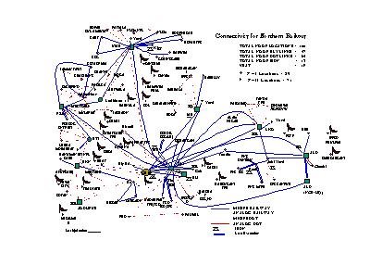
FOIS Network – An outline
Based on a hierarchical tree topology
Heterogeneous Communication Media.
  Railway owned OFC
  Railway owned digital microwave
  Leased channels from BSNL.
  ISDN
  VSAT based satellite links.

Slide 29
Works On Hand in FOIS
Control Office Applications = TVC, MDU, WAT, KUR AND KGP AND Entire network of TVC – HWH Section before the end of this year
Networked Crew management system for Central and western Railway
MIS – Data Warehousing and Data Mining – Initially for one zone and one division planned
Payment gateway for more major customers
Web enabling of FOIS
Revenue Accounting System
RFID – immediate need for Pilot Project

Slide 30

Coaching Operation Information System
COIS Phase I - Punctuality Module implemented with Information Feeding Terminals provided in all Divisional controls, Zonal headquarters and in Railway Board.
Punctuality reports for Divisions, Zonal Railways and Railway Board
COIS Phase II - Coach Management System (CMS) under testing
PHASE III –TIME TABLING

Slide 31
Web enabled Claims
Implementation completed at all 16 Zonal Railways in Feb 2005.
The website has also been opened for general public from Feb 2005
Computerization of Railway Claims Tribunals, Goods-Refund & Subsidiary Claims Offices have been approved for development and implementation in the year 2005
The estimates for the above mentioned projects had been submitted to the Railway Board
Design work is in progress for these projects

Slide 32
Parcel Management System
Following Functions are covered
  Parcel Booking, Cancellation and Loading
  monitoring and tracking of Parcels
  Demurrage and Wharfage Calculation
  Printing of Parcel labels
Networking of all parcel offices
RFID tags for tracing parcels

Slide 33


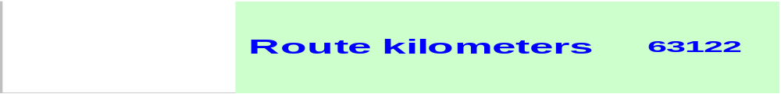
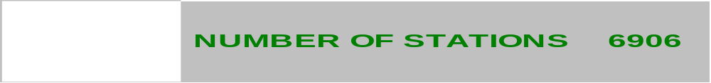
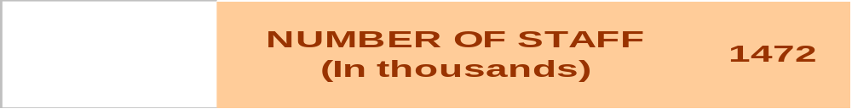
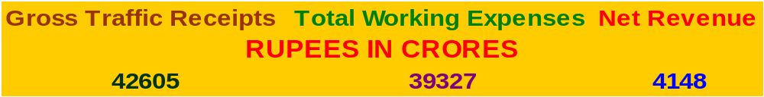
INDIAN RAILWAYS

Slide 34
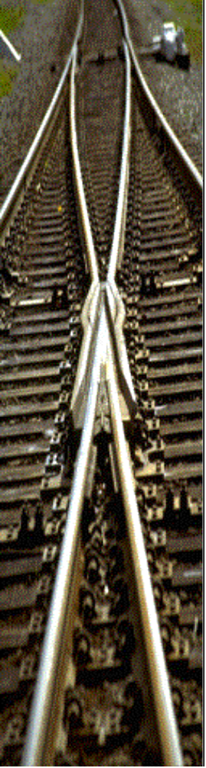

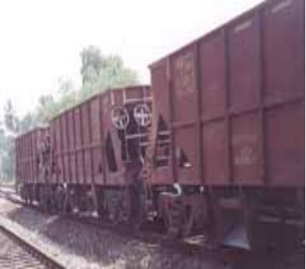
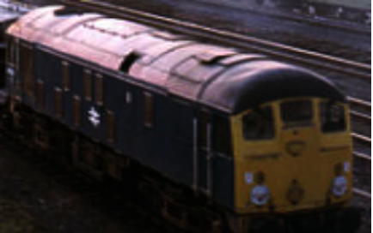
INDIAN RAILWAYS
ASSETS PROFILE
Total Track Kilometers 109,221
Electrified Track kilometers 39,358
No Of Bridges 119,984
No Of Level Crossings 37,423
No Of Passenger Coaches 34,895
No Of Emu/Dmu coaches 4,957
Other Coaching Vehicles 4,904
Total Wagons On Line 214,760
No Of Diesel Locomotives 4,699
No Of Electric Locomotives 2930

Slide 35
MIS Project Overview
MIS Project started with three pilot railways viz. NR, SR & CR
The development of functional modules entrusted to railways are as under:
Civil-CR & NR, Elec. – CR & NR, Mech.-SR,
S&T-SR, Security-NR, Vigilance-WR
Objective to provide MIS for each department
Railway Board decision to transfer the existing contract management to CRIS from pilot railways to implement MIS applications on centralised Architecture awaited

Slide 36
Workshop Computerisation
Project to be completed in 2 phases.
1st Phase includes 16 workshops on which the work is under progress. To be completed by the end of this year
In phase – 2, 15 more workshops will be considered for implementation. Estimate sanctioned.
Three major modules
  Rolling Stock Management (RMS)
  Production Planning and Control (PPC)
  Machine & Plant (M&P).
Training of staff and procurement of hardware is in progress.

Slide 37
Health Management Information System (HIMS)
A centralized solution for implementation of HMIS across all the hospitals and health units of IR
A prototype for some of the basic modules of HMIS developed and given for testing to Vadodara division
A proposal for development and deployment of HMIS as pilot project on western railway is submitted to railway board and approval awaited

Slide 38

Rail Budget Compilation System (RBCS) . A web-enabled works programme management system is being developed and linked to same
Comprehensive Accounting & Transaction System (CATS) for RDSO
Comprehensive Pay Roll Processing System (CPPS) for DLW
Railway Officers Information System (ROIS)
Data Center for Zonal railways
MIS for zonal railways

Slide 39
CONSOLIDATION OF INFORMATION
Computerisation on Indian Railways have been mainly in the form of Data Processing Applications
Organisations want to be provided with information that will help them to understand their business processes better - Business Intelligence (BI).
Pressing need to provide interactive and analytical information to the managers of Indian Railways for a better understanding of the current business process and arriving at appropriate rational decisions.
Applications to be integrated with the Integrated MIS System of IR
An Indian Railway Portal to address all the information requirements of IR managers.

Slide 40
Challenges faced by Railways
Large Geographical Dispersion
Diverse Computing Platforms
Remote Network POPs
24x7 operations throughout the Year
OLTP applications support Public Services
Demanding Missions to accomplish
Heterogeneous Networks

Slide 41
IT STRATEGIES OF IR
Applications should transcend boundaries of railway organisation and go into the domain of the customer.
Implement decision support systems
Integration with communication systems and other technologies.-use of Internet, mobile phones, hand held terminals, universal product code readers etc
Manage continuous improvement in technology.

Slide 42
Future Trends in IT in Railways
Leverage on the state-of-the-art technology to be more competitive and reduce cost
Killer Applications
  Ticketing Solutions (Centralised, Stand-alone, Mobile, Smart Card, Self Service, Internet etc.); value added services to customer
  On line and e-enabled Freight Management System
  Integrated revenue accountal system
  Train Charting and Control Systems
  RFID based Wagon/Parcel Tracking Systems
  Integration of Railway Systems with Railway Station Systems
  Integrated Materials Management System / Fixed assets mgmt
  Safety Systems (GPS, Embedded Systems)
  GIS based Track Maintenance Systems

Slide 43
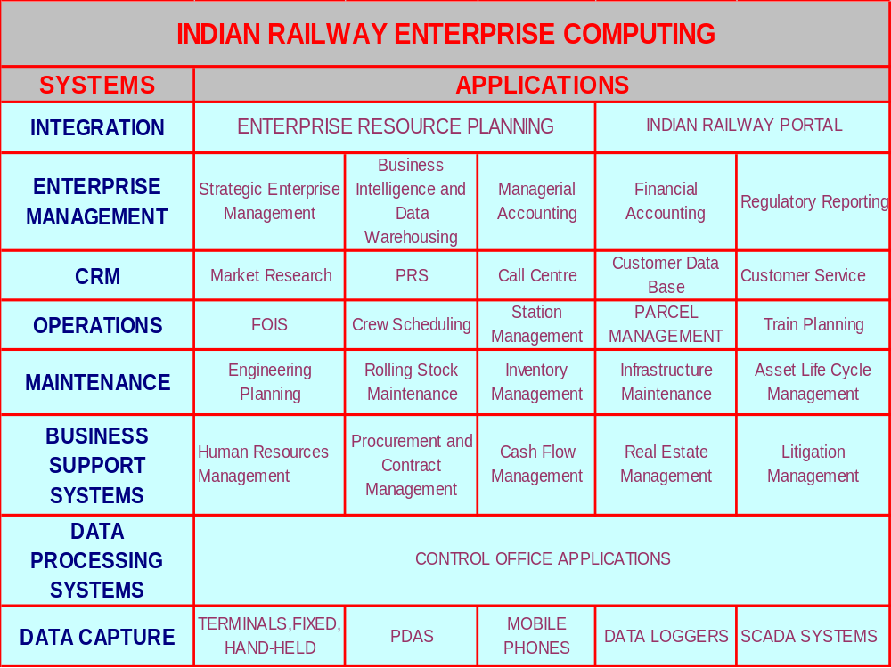

Slide 44
A Service-Oriented IT Vision For IR
E-enabled Freight Management System
Customer care centers
Intelligent Stations Infrastructure
Self service kiosks at Stations
Smart and Stored Value Cards for MST / Passes
RFID based Smart card & Biometric technology for passenger screening
Re-vamped Revenue Management
Operations & Scheduling
Staff Management
Yield Management
WAP Gateway
WAP Applications and WML Pages
SMS Gateway
Payment Gateway
ERP for IR
An IR PORTAL

Slide 45
THANK YOU

